Slide 1


Automation of Weather-Based Sales and Staffing Decisions
John McDaniel
AI Automation | Project 5

Slide 2

Problem
Beachside coffee & ice cream kiosk in Miami is highly affected by fast-changing coastal weather
Hot, humid mornings drive higher iced coffee and gelato sales
Windy days reduce beach traffic but increase local comfort-food purchases
Manager currently checks weather manually, causing delays and inefficiency

Slide 3
Solution
Automatically fetch Miami’s daily weather forecast at 7:00 AM
Use AI to analyze the forecast and generate:
Product mix recommendations (hot drinks, cold drinks, gelato, pastries)
Staffing suggestions based on expected conditions
Two short, weather-based customer promo messages
Email the manager a friendly daily summary
Optional: Send special alerts for severe weather (over 91°F, heavy rain, or storms)

Slide 4
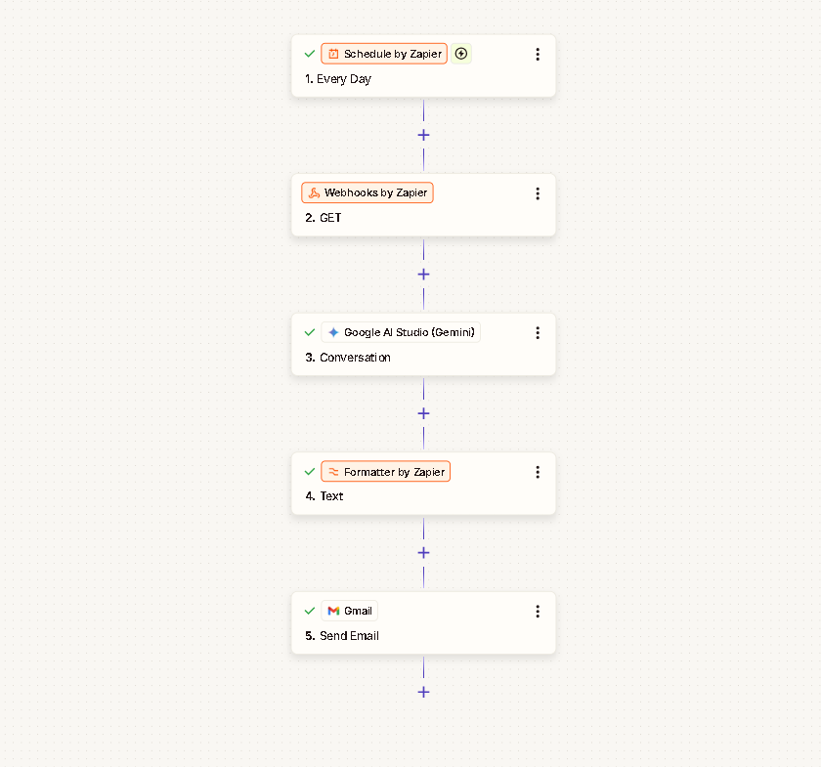
Zapier Workflow Diagram

Slide 5
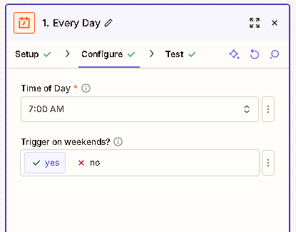
Workflow In Action (Schedule)

Slide 6
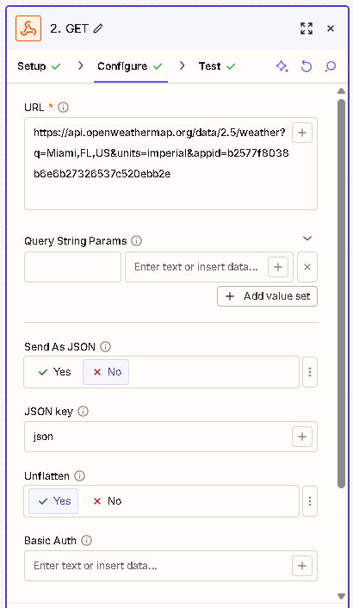
Workflow In Action (Webhooks)

Slide 7
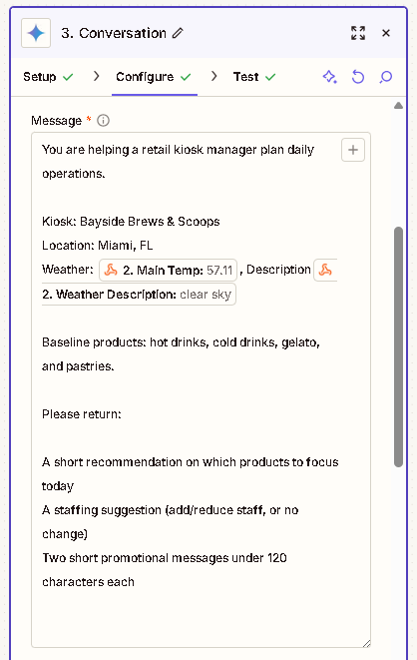
Workflow In Action (Gemini)

Slide 8
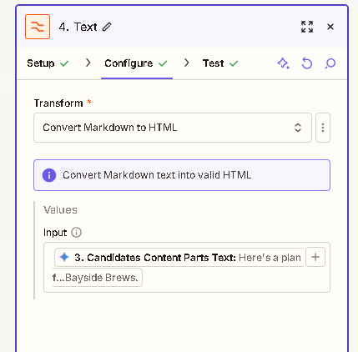
Workflow In Action (Formatter)

Slide 9
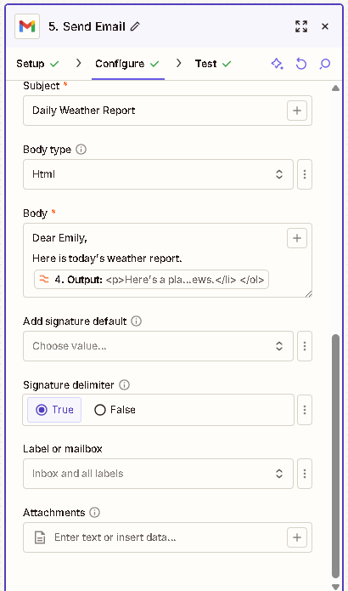
Workflow In Action (Gmail)

Slide 10
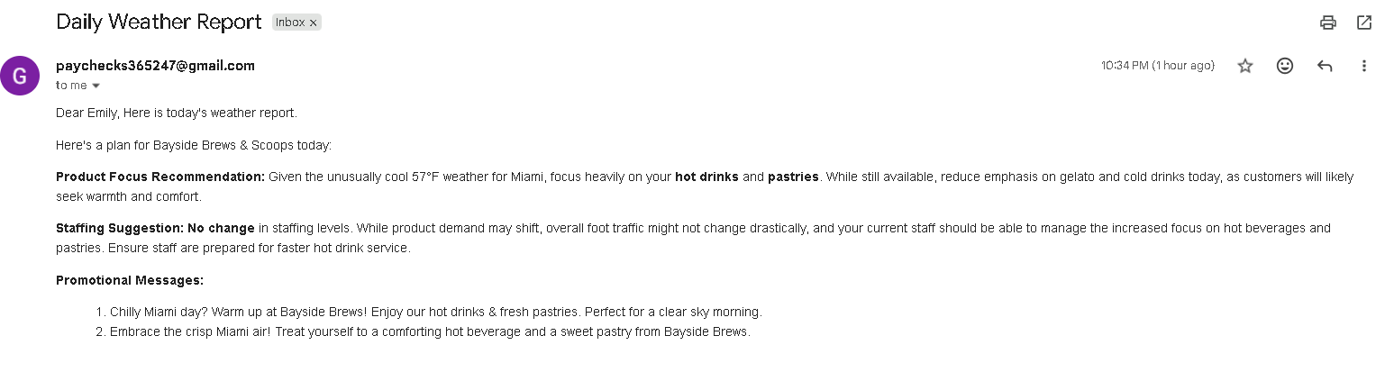
Workflow In Action (Gmail)

Slide 11
Benefits
1.
Saves time and reduces manual effort by automating daily weather checks and planning
2.
Improves sales and customer engagement with weather-optimized product mixes and promotions
3.
Enhances staffing efficiency and preparedness, especially during extreme or changing weather conditions

Slide 12
Challenges & Improvements
What worked well:
Clear automation goals tied directly to real business needs (sales, staffing, promotions)
Effective use of weather data + AI to turn forecasts into actionable decisions
Simple daily email delivery that fits naturally into the manager’s routine
Improvements made with more time or tools:
Integrate historical sales data to make recommendations more accurate over time
Add real-time or intraday weather updates to adjust plans dynamically
Expand alerts and promos to additional channels (SMS, POS display, social media)

